Slide 1
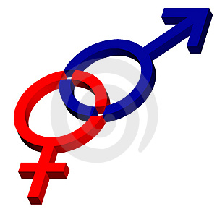
REPRODUCTIVE
SYSTEM

Slide 2
Male R_{o} Learning OUtcomes
# | Learning Outcomes | Text Pages
P1 | Identify and give functions for each of the following: testes (seminiferous tubules and interstitial cells), epididymis, ductus (vas) deferens, prostate gland, cowper's gland, seminal vesicles, penis. | P. 416-417
P2 | Demonstrate a knowledge of the path of sperm from the seminiferous tubules to the urethral opening. | P. 414-415
P3 | List the functions of seminal fluid. | P. 414-415
P4 | Identify the tail, midpiece, head, and acrosome of a mature sperm and state their functions. | P. 416-417
P5 | Describe the functions of testosterone. | P. 417
P6 | Demonstrate a knowledge of the control of testosterone levels the endocrine system. | P. 417

Slide 3
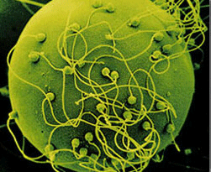
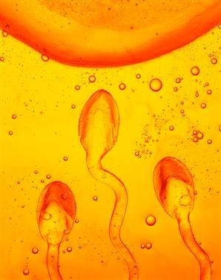
HUMAN REPRODUCTION
The goal of the reproductive system is to pass on your genetic code onto a new and unique generation. This is ultimately accomplished via fertilization.

Slide 4
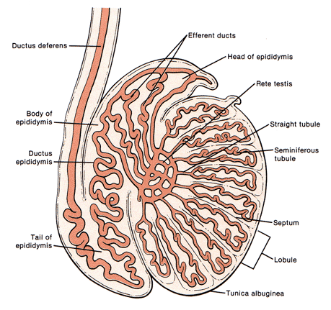
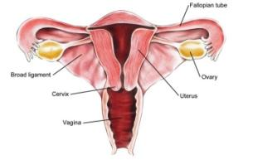
HUMAN REPRODUCTION
Human reproduction employs internal fertilization, and depends on the integrated action of hormones, the nervous system, and the reproductive system.
Male gonads are the testes, which produce sperm and testosterone.
Female gonads are the ovaries which produce eggs and 2 hormones: estrogen estrogen and progesterone.

Slide 5
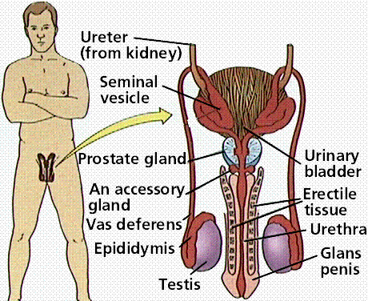

Slide 6
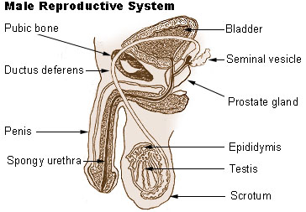
http://www.youtube.com/watch?v=WEzcK-OKd10

Slide 16
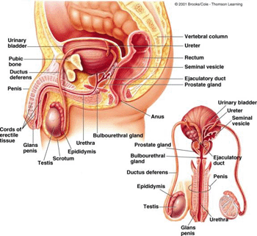

Slide 17
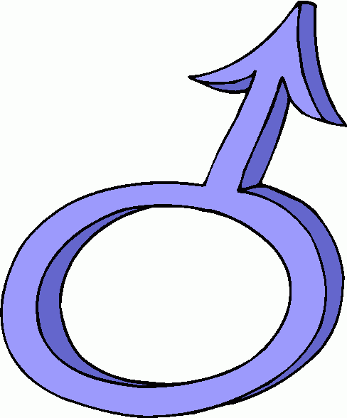
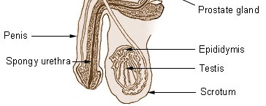
MALE REPRODUCTION
Male Anatomy
The male external genitalia are the scrotum and penis.
The scrotum is a fold of skin that encloses the male gonads (testes)

Slide 18
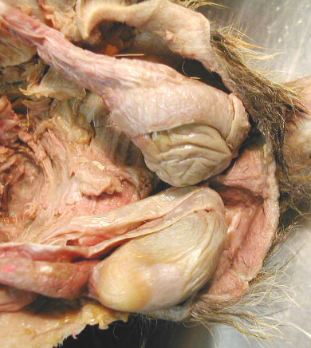
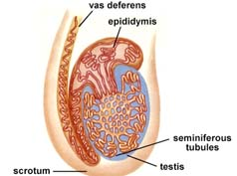
MALE REPRODUCTION
scrotum
testes

Slide 19
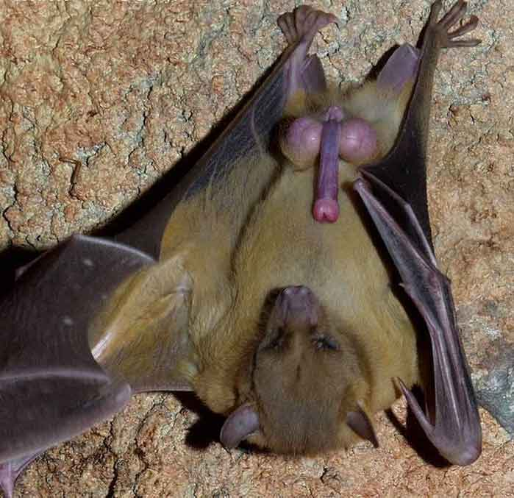
MALE REPRODUCTION
Male fruit bat of the species Rousettus aegyptiacus have testes that are 2.15 % of body mass, whereas their brains are only 1.70 %.
The males in some bat species can have testes that are up to 8.5 % of their body mass.

Slide 20
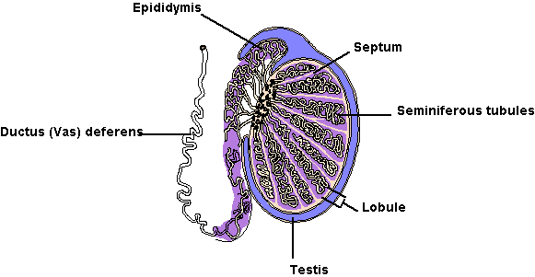
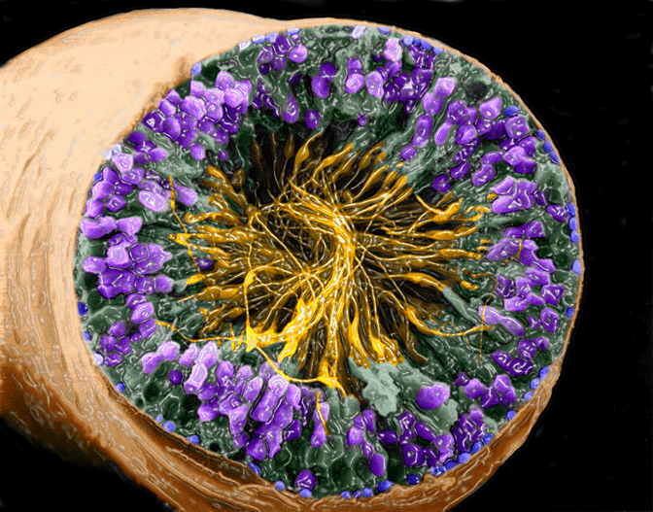
MALE REPRODUCTION
The testes are a pair of tightly coiled tubes surrounded by several layers of connective tissues.
These tubes are the SEMINIFEROUS TUBULES, where sperm are produced by meiosis.
About 250 meters of tubules are packed into each testis.

Slide 21
MALE REPRODUCTION

Slide 22
MALE REPRODUCTION

Slide 23
MALE REPRODUCTION

Slide 24
MALE REPRODUCTION

Slide 25
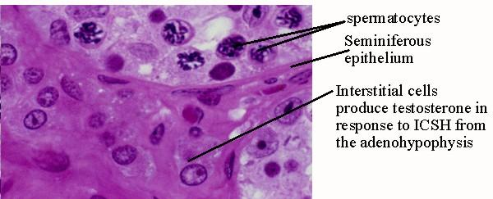
MALE REPRODUCTION
The INTERSTITIAL CELLS are scattered between the seminiferous tubules in the testes.
These cells produce testosterone.

Slide 26
MALE REPRODUCTION
Sperm production cannot occur at normal body temperature.
So just before birth, the testes descend to hang outside the abdominal cavity in the scrotum, a fold of skin.
The temperature in the scrotum is ~2ºC below body temperature.

Slide 27
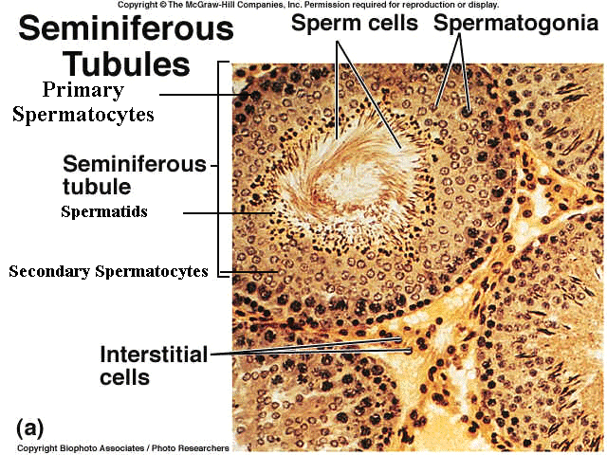

Slide 28
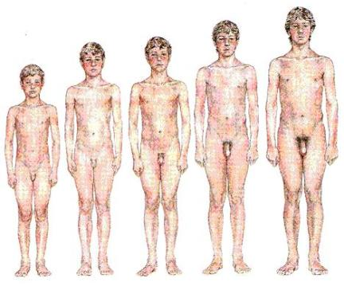
MALE REPRODUCTION
SPERMATOGENESIS
The process from spermatogonia to motile sperm, takes 65-75 days in the human male.
Each ejaculation of a human male contains about 400 million sperm cells.
Sperm production begins at puberty and continues throughout life, with several hundred million sperm being produced each day.

Slide 29
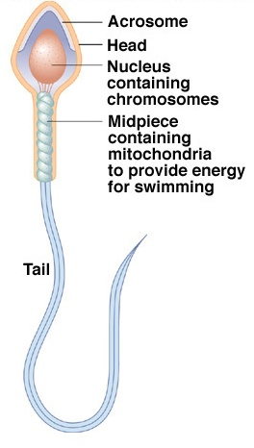
PARTS OF SPERM CELL
SPERM CELLS
The structure of a sperm cell fits its function.
The thick head contains the haploid nucleus and is tipped with a special body, the acrosome. The acrosome contains enzymes that help the sperm penetrate the egg.
The neck contains large numbers of mitochondria that provide ATP for movement.
The tail is a flagellum which moves the sperm.

Slide 30
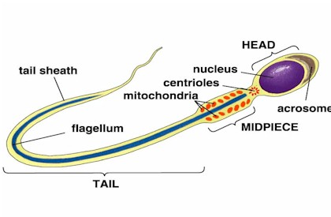

Slide 31
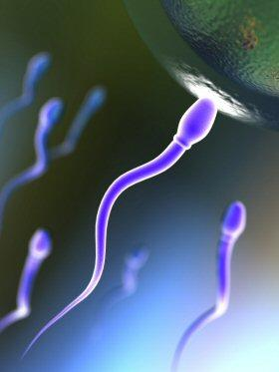
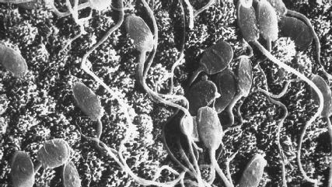
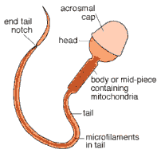
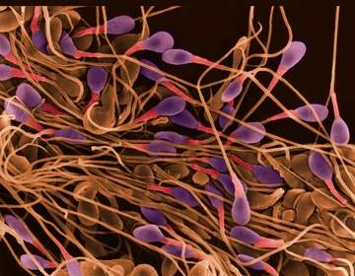
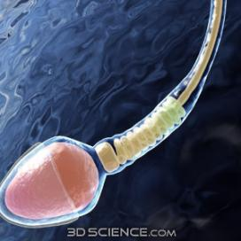

Slide 32
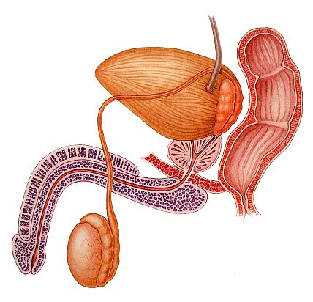
MALE REPRODUCTION
During ejaculation, the sperm are propelled from the epididymis through the muscular VAS DEFERENS ducts, which run from the scrotum around and behind the bladder, where they join to form a short EJACULATORY DUCT.
This duct opens into the URETHRA, the tube which drains both the excretory and reproductive systems (never both at the same time).
The urethra runs through the penis and opens to the outside at the tip of the penis.

Slide 33
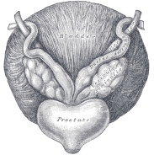
SEMINAL FLUID
In addition to the testes and ducts, the male reproductive system contains three sets of glands that add their secretions to the SEMEN (the fluid ejaculated).
SEMINAL VESICLES: contribute about 60% of the total volume of semen. This pair of glands lies below and behind the bladder and empties into the ejaculatory duct.
The fluid is thick and clear and contains mucous, amino acids, and large amount of fructose (which provides energy for the sperm).
These vesicles also secrete PROSTAGLANDINS, which once in the female reproductive tract, stimulate contractions of the uterine muscles that help move the semen up into the uterus.
Proteins in the seminal fluid cause the semen to coagulate after it is deposited in the female, thus, making it easier for uterine contractions to move the semen.

Slide 34
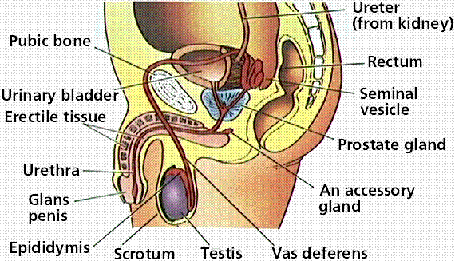
MALE REPRODUCTION

Slide 35
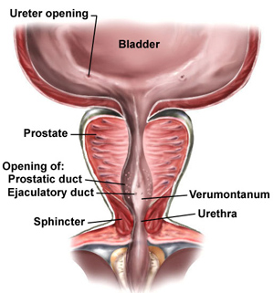
MALE REPRODUCTION
PROSTATE GLAND:
This is the largest of the accessory glands.
Prostatic fluid is thin, milky, and quite alkaline, which balances the acidity of any residual urine in the urethra and the natural acidity of the vagina.

Slide 36
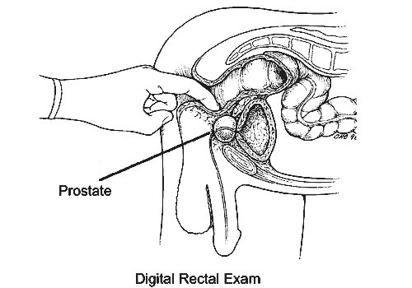
MALE REPRODUCTION
PROSTATE GLAND:
This gland is the sources of some of the most common medical problems of men over 40.
A benign enlargement of the prostate occurs in more than ½ of all men in this age group.
That is why it is important to get tested annually after the age of 40.

Slide 37
MALE REPRODUCTION

Slide 38
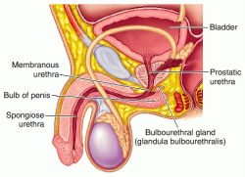
MALE REPRODUCTION
BULBOURETHRAL GLANDS (cowper’s gland):
These are a pair of small glands along the urethra below the prostate.
They secrete a viscous fluid before emission of the semen.
It has been suggested that this fluid lubricates the penis and vagina, but the volume (just one or two drops) seems insufficient to be very effective for this function.
This fluid does carry some sperm released before ejaculation,.
This is one factor in the low success rate of the withdrawal method of birth control.

Slide 39
MALE REPRODUCTION

Slide 40
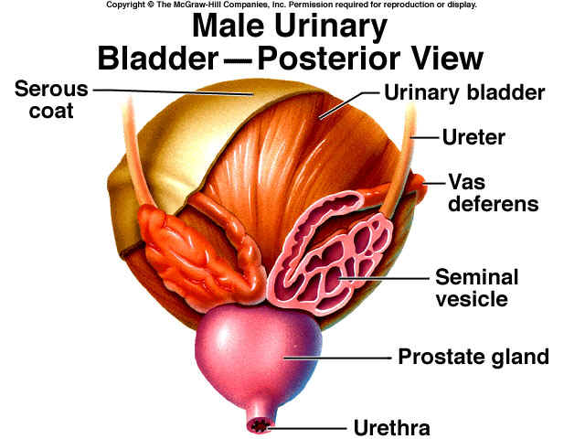

Slide 41
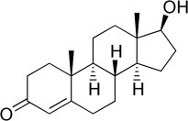
HORMONES
MALE SEX HORMONES
The principal male sex hormones are the androgens, of which, testosterone is the most important.
Androgens are steroid hormones produced by the interstitial cells of the testes, and are directly responsible for the primary and secondary sex characteristics of the male.
Androgens are also potent determinants of behaviour in mammals.
In addition to specific sexual behaviour and libido (sex drive), androgens increase general aggressiveness.

Slide 42
CONSEQUENCES OF USE:
*ROID RAGE (extreme uncontrollable aggression)
* Irritable and depressed.
* Low sex drive
* Possible cancer & liver damage
* Feminizing effects in males (growth of breast tissue)…
* Shrunken testicles…
* Limb loss…
* Heart disease/heart attacks…
* HIV/AIDS from the sharing of needles…

Slide 43
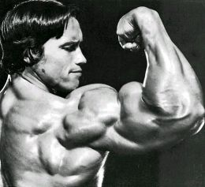
CONSEQUENCES OF USE:
* Reduced sperm count…
* Impotence & Infertility…
* Baldness…
* Pain & difficulty urinating…
* Enlarged prostate…
* Adolescents experience stunted growth…

Slide 44
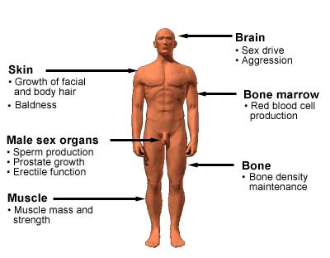

Slide 45
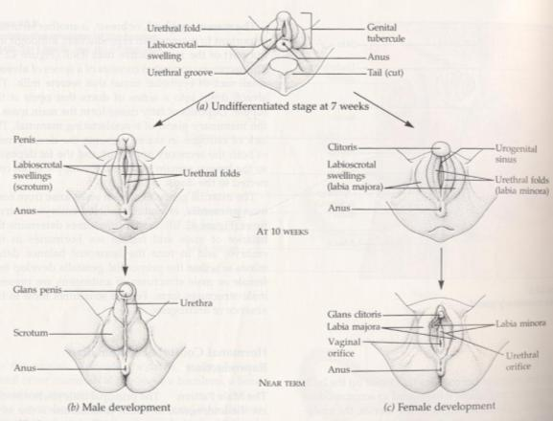
MALE REPRODUCTION
MALE SEX HORMONES
Primary sex characteristics: development of the vas deferens and other ducts, the eternal genitalia, and sperm production.
All babies start as female. If testosterone is present, they will become male, if not, they will be born female.
Sex is determined by 13 weeks, sex is determined.

Slide 46
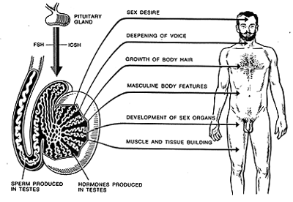
MALE REPRODUCTION
MALE SEX HORMONES
Secondary sex characteristics: features we associate with maleness such as: deepening of the voice, the male distributions of axillary (armpit), facial, and pubic hair, and muscle growth (androgens stimulate protein synthesis).

Slide 47
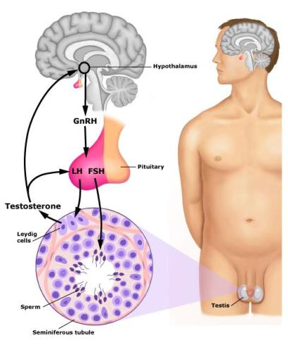
HOMEOSTATIC REGULATION
The hypothalamus makes a hormone called GnRH
(the gonadotropin-releasing hormone).
GnRH control the release of two hormones from the anterior pituitary:
1. Follicle-stimulating hormone
(FSH)
2. Luteinizing hormone
(LH)

Slide 48
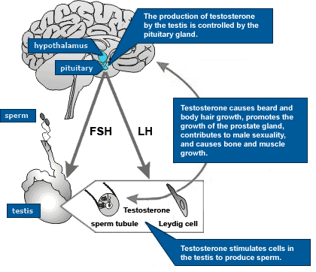
HOMEOSTATIC REGULATION
LH stimulates the interstitial cells in the seminiferous tubules to secrete testosterone.
Testosterone has a role in sperm production and developing male secondary sex characteristics.
FSH acts on the epidymis to help in sperm maturation.

Slide 49
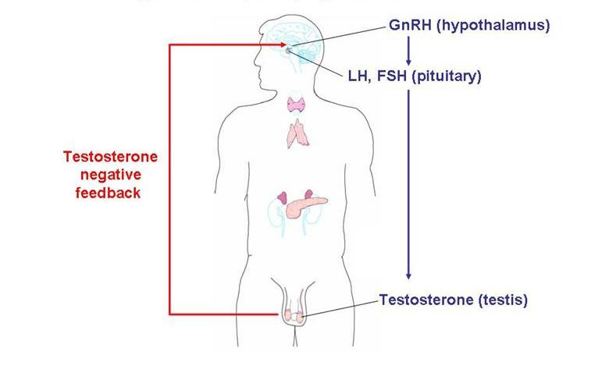
HOMEOSTATIC REGULATION
Negative feedback by testosterone controls the actions of GnRH.

Slide 50
HOMEOSTATIC REGULATION
Hypothalamus
GnRH
-

Slide 51
HOMEOSTATIC REGULATION
Hypothalamus
GnRH
-
Anterior Pituitary
LH & FSH

Slide 52
HOMEOSTATIC REGULATION
Hypothalamus
GnRH
-
Anterior Pituitary
LH & FSH
FSH
Follicle stimulating hormone

Slide 53
HOMEOSTATIC REGULATION
Hypothalamus
GnRH
-
Anterior Pituitary
LH & FSH
FSH
Follicle stimulating hormone
Epidydimis

Slide 54
HOMEOSTATIC REGULATION
Hypothalamus
GnRH
-
Anterior Pituitary
LH & FSH
FSH
Follicle stimulating hormone
Epidydimis
Matures the sperm
(makes it motile)

Slide 55
HOMEOSTATIC REGULATION
Hypothalamus
GnRH
-
Anterior Pituitary
LH & FSH
FSH
Follicle stimulating hormone
Epidydimis
Matures the sperm
(makes it motile)
Fish swim

Slide 56
HOMEOSTATIC REGULATION
Hypothalamus
GnRH
-
Anterior Pituitary
LH & FSH
LH
luteinizing hormone
FSH
Follicle stimulating hormone
Epidydimis
Matures the sperm
(makes it motile)

Slide 57
HOMEOSTATIC REGULATION
Hypothalamus
GnRH
-
Anterior Pituitary
LH & FSH
LH
luteinizing hormone
FSH
Follicle stimulating hormone
Interstitial Cells
Epidydimis
Matures the sperm
(makes it motile)

Slide 58
HOMEOSTATIC REGULATION
Hypothalamus
GnRH
-
Anterior Pituitary
LH & FSH
LH
luteinizing hormone
FSH
Follicle stimulating hormone
Interstitial Cells
Epidydimis
Testosterone
Matures the sperm
(makes it motile)

Slide 59
HOMEOSTATIC REGULATION
Hypothalamus
GnRH
-
Anterior Pituitary
LH & FSH
LH
luteinizing hormone
FSH
Follicle stimulating hormone
Interstitial Cells
Epidydimis
Testosterone
Matures the sperm
(makes it motile)
Sperm production
2º sex characteristics
deep voice, body hair, more muscle, libido…

Slide 60
HOMEOSTATIC REGULATION
Hypothalamus
GnRH
-
Anterior Pituitary
LH & FSH
Teens have a Love Hate relationship with testosterone
LH
luteinizing hormone
FSH
Follicle stimulating hormone
Interstitial Cells
Epidydimis
Testosterone
Matures the sperm
(makes it motile)
Sperm production
2º sex characteristics
deep voice, body hair, more muscle, libido…

Slide 61
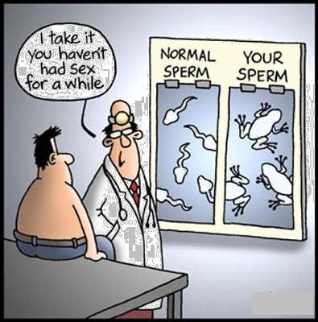
MALE REPRODUCTION

Slide 62
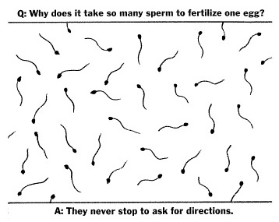
MALE REPRODUCTION

Slide 63
FeMale R_{o} Learning OUtcomes
# | Learning Outcome | Text Pages
P7 | Identify and give a function for each of the following: ovaries (follicles and corpus luteum), oviducts (fallopian tubes), uterus, cervix, vagina, clitoris. | P. 418-419
P8 | Describe the functions of estrogen. | P. 421-424
P9 | Describe the sequence of events in the ovarian and uterine cycles. | P. 420-423
P10 | Demonstrate knowledge of the control of the ovarian and uterine cycles by hormones. | P. 420-423
P11 | Demonstrate knowledge of a positive feedback mechanism involving oxytocin. | P. 208, 394
P12 | Describe the hormonal changes that occur as a result of implantation. | Page 424

Slide 64
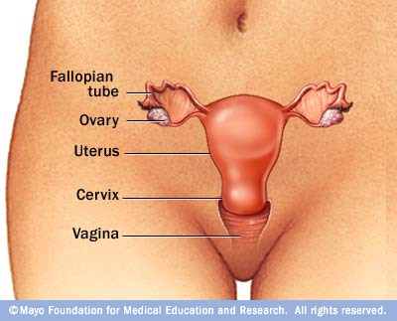

Slide 65
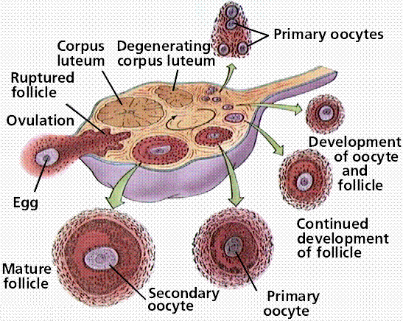
FeMale R_{o} Learning OUtcomes
The female gonads, ovaries, are located within the lower abdominal cavity, below most of the digestive system.
Each ovary is enclosed in a tough protective capsule and contains many follicles.

Slide 66
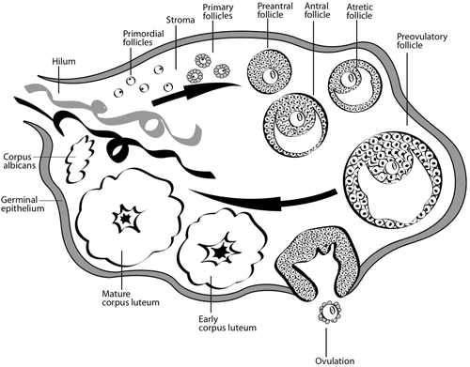
FEMALE REPRODUCTION
A FOLLICLE consists of one egg cell surrounded by one or more layers of follicle cells, which nourish and protect the developing egg cell.
All of the 400,000 follicles a woman will ever have are formed at birth.
Of these, only several hundred will be released during the woman’s reproductive years.

Slide 67
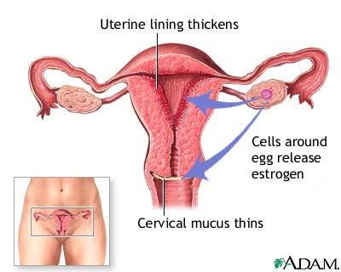
FEMALE REPRODUCTION
After puberty, one (or rarely two or more) follicles matures and releases its egg during each menstrual cycle.
The cells of the follicle also produce the primary female sex hormones, ESTROGEN.

Slide 68
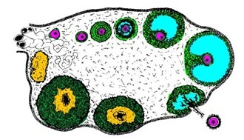
FEMALE REPRODUCTION
The remaining follicular tissue grows within the ovary to form a solid mass called the CORPUS LUTEUM.

Slide 69
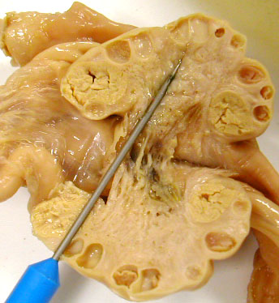

Slide 70
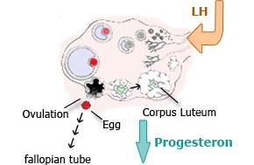
FEMALE REPRODUCTION
The corpus luteum secretes PROGESTERONE (the hormone of pregnancy) and additional estrogen.
If the egg is not fertilized, the corpus luteum degenerates and a new follicle matures during the next cycle.

Slide 71
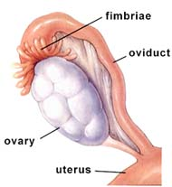
FEMALE REPRODUCTION
The female reproductive system is not completely closed.
The egg cell is expelled into the abdominal cavity near the opening of the OVIDUCT (or fallopian tube).

Slide 73
FEMALE REPRODUCTION
The fimbriae on the oviduct sweep the ovary for the egg, and the cilia on the inner epithelium lining the duct help collect the egg cell by creating a current to draw fluid into the duct.

Slide 74
FEMALE REPRODUCTION

Slide 75
Ovarian Cysts

Slide 76
FEMALE REPRODUCTION

Slide 77
FEMALE REPRODUCTION
The oviduct is the site of fertilization.
The cilia in this duct also convey the egg cell down the duct to the UTERUS (womb).

Slide 78
FEMALE REPRODUCTION
The UTERUS is a thick, muscular organ (shaped like an upside down pear).
It is remarkably small; the uterus of a woman who has never been pregnant is about 7 cm long and 4-5 cm wide at its widest.

Slide 79
FEMALE REPRODUCTION
The unique arrangement of muscles that make up the uterine wall allow it to expand to accommodate a 4 kg (?lb) fetus.

Slide 80
FEMALE REPRODUCTION
The inner lining of the uterus, the ENDOMETRIUM, is richly supplied with blood vessels, in which a fertilized egg implants and develops.

Slide 81
FEMALE REPRODUCTION
The narrow neck of the uterus is the CERVIX, which opens into the VAGINA.
The vagina is a thin-walled chamber that forms the birth canal through which the baby is expelled; it is also the receptacle for the man’s penis.

Slide 82
FEMALE REPRODUCTION

Slide 83
FEMALE REPRODUCTION

Slide 84
FEMALE REPRODUCTION

Slide 85
FEMALE REPRODUCTION

Slide 86
FEMALE REPRODUCTION

Slide 87
FEMALE REPRODUCTION

Slide 88
FEMALE REPRODUCTION

Slide 89
FEMALE REPRODUCTION

Slide 90
FEMALE REPRODUCTION

Slide 91
FEMALE REPRODUCTION

Slide 92
FEMALE REPRODUCTION

Slide 93
FEMALE REPRODUCTION

Slide 94
FEMALE REPRODUCTION

Slide 95
FEMALE REPRODUCTION
The lack of estrogen in males prevents the development of both the secretory apparatus and the fat deposits, so the breasts remain small and the nipple is not connected to the ducts.

Slide 96
FEMALE REPRODUCTION
THE FEMALE HORMONE CYCLES
Two different types of cycles occur in the female mammals:
1. The menstrual cycle
2. The ovarian cycle

Slide 97
FEMALE REPRODUCTION
The Menstrual Cycle
The human menstrual cycle refers specifically to the changes that occur in the uterus.
It lasts an average of 28 days, but only ~30% of women have cycle lengths within a day or two of the statistical 28 days. Cycles vary from about 20 to 40 days. In some women the cycles are usually very regular, but in other individuals the timing varies from cycle to cycle.

Slide 98
FEMALE REPRODUCTION
MENSTRUAL CYCLE : This cycle occurs in the uterus. There are 3 phases in this cycle.
Day 1 is the first day of a woman’s ‘period’ (1st day of menstruation)
THREE PHASES OF THE MENSTRUAL CYCLE
The Flow phase: Menstrual bleeding usually persists for a few days (day 2-8).
The Proliferative phase: the endometrium begins to thicken for a week or two (until ovulation).
The Secretory phase: usually about 2 weeks long, the endometrium continues to thicken, becomes more vascularized and secretes a fluid rich in glycogen to prepare for a fertilized egg.

Slide 99
FEMALE REPRODUCTION
MENSTRUAL CYCLE
*If an embryo has not implanted in the uterine lining by the end of the secretory phase, a new menstrual flow commences.
*If an embryo is implanted before the end of the secretory phase, the endometrium will remain until birth.

Slide 100
FEMALE REPRODUCTION
THE OVARIAN CYCLE: This cycle occurs in the ovaries. There are THREE phases in this cycle
THREE PHASES OF THE OVARIAN CYCLE:
This cycle begins with the FOLLICULAR PHASE, during which several follicles in the ovary begin to grow and release estrogen.
The maturing follicle develops an internal fluid-filled cavity and grows very large, forming a bulge near the surface of the ovary.

Slide 101
FEMALE REPRODUCTION
THREE PHASES OF THE OVARIAN CYCLE:
The follicular phase ends with OVULATION when the follicle and adjacent wall of the ovary rupture, releasing the egg cell. The egg cell is transported into the oviduct and is transported into the uterus.

Slide 102
FEMALE REPRODUCTION
THREE PHASES OF THE OVARIAN CYCLE:
The last phase is the LUTEAL PHASE. During this phase, the follicular tissue that remains in the ovary after ovulation is transformed into the corpus luteum.
The corpus luteum is an endocrine tissue that synthesizes and secretes hormones to prepare the uterus for pregnancy.

Slide 103
FEMALE REPRODUCTION
The next cycle begins with growth of new follicles.
These cyclic phases are interrupted only by pregnancy and continue until menopause, when reproductive capability ends.

Slide 104
FEMALE REPRODUCTION
THE FEMALE SEX HORMONES
Hormones coordinate the menstrual and ovarian cycles in such a way that growth of the follicle and ovulation are synchronized with preparation of the uterine lining for possible implantation of an embryo.
5 hormones participate in both (+) and (-) feedback cycles:
Gonadotropin-releasing hormone (GnRH): secreted by the hypothalamus
Follicle stimulating hormone (FSH): secreted by anterior pituitary
Luteinizing hormone (LH): secreted by anterior pituitary
Estrogen: secreted by ovary (follicle)
Progesterone: secreted by ovary (corpus luteum)

Slide 105
FEMALE REPRODUCTION

Slide 106
FEMALE HORMONE CONTROL
#1
During the follicular phase of the ovarian cycle, the hypothalamus releases GnRH.
This causes the anterior pituitary to secrete small quantities of FSH and LH.
#2

Slide 107
FEMALE HORMONE CONTROL
At this time, the follicles in the ovary have receptors for FSH, but not for LH.
The FSH causes the follicles to grow.
The follicles release estrogen as they grow.
The amount of estrogen
secreted during this time
is small.
#3
#4

Slide 108
FEMALE HORMONE CONTROL
#1
#7
When the [estrogen] secretion begins to rise, it causes the hypothalamus to release more GnRH (positive feedback).
GnRH causes even more LH and FSH to be released from the anterior pituitary.
This causes the LH SURGE.
#6
#5

Slide 109
FEMALE HORMONE CONTROL
By now, the follicles have receptors for LH and can respond to this hormonal cue.
The LH SURGE induces final maturation of the follicle.
Ovulation occurs on day 14, about one day after the LH surge.
#9
#8

Slide 110
FEMALE HORMONE CONTROL
After ovulation, LH will stimulate the follicle to become the corpus luteum.
LH will also stimulate the corpus luteum to start secreting estrogen and progesterone.
#10
#11

Slide 111
FEMALE HORMONE CONTROL
#13
The corpus luteum reaches its maximum development about 8-10 days after ovulation. At this point there is very high [progesterone] and [estrogen] in the blood.
High levels of these hormones exerts negative feedback on the hypothalamus.
This causes a severe decrease in the amounts of LH and FSH.
#14
#12

Slide 112
FEMALE HORMONE CONTROL
When [LH] plummets, the corpus luteum begins to degenerate.
This causes a sharp decrease in the [estrogen] and [progesterone].
Without these hormones, the endometrium layer is sloughed off and day one of the cycle begins again.
#14
#15
#16
#17

Slide 113
FEMALE HORMONE CONTROL
#18
As these hormones drop off, the hypothalamus and pituitary are not inhibited anymore.
So the anterior pituitary begins to secrete enough FSH to stimulate growth of new follicles in the ovary.
This initiates the follicular phase of the next ovarian cycle.
#19
#20

Slide 114
FEMALE REPRODUCTION
How is the ovarian cycle synchronized with the menstrual cycle?
Follicular phase/proliferative phase: Estrogen (which is released by follicles in the follicular phase) is a hormonal signal to the uterus, which stimulates the development of the endometrium (proliferative phase).
FOLLICULAR PHASE
estrogen
PROLIFERATIVE PHASE

Slide 115
FEMALE REPRODUCTION
How is the ovarian cycle synchronized with the menstrual cycle?
Luteal phase/secretory phase: After ovulation, estrogen and progesterone secreted by the corpus luteum stimulate continued development and maintenance of the endometrium (secretory phase) as the body prepares for the possibility of a fertilized egg.
LUTEAL PHASE
progesterone
SECRETORY PHASE

Slide 116
FEMALE REPRODUCTION
How is the ovarian cycle synchronized with the menstrual cycle?
A rapid drop in the level of estrogen and progesterone hormones when the corpus luteum degenerates causes spasms of the arteries in the uterine lining that deprive the endometrium of blood.
Degeneration of the endometrium results in menstruation and the beginning of a new menstrual cycle.
In the meantime, ovarian follicles that will stimulate renewed thickening of the endometrium are just beginning to grow.
Corpus luteum dies
Low E &P
MENSES
Day 1

Slide 118
FEMALE REPRODUCTION
In addition to their role in coordinating reproductive cycles, estrogens are also responsible for the secondary sex characteristics of the female:
Deposition of fat in the breasts and hips
Increase in water retention
Affects calcium metabolism
Stimulates breast development
Mediates female sexual behavior
Initiates female libido
PMS
Mood swings
Cravings (chocolate, cheese, milk…)
Growth of hair (not as much as men)

Slide 119
WHAT HAPPENS IF THE EGG IS FERTILIZED?

Slide 120
WHAT HAPPENS IF THE EGG IS FERTILIZED?

Slide 121
WHAT HAPPENS IF THE EGG IS FERTILIZED?
If the egg is fertilized, the resulting embryo will start to release a hormone called human chorionic gonadotropin (HCG).
HCG acts like LH to maintain the corpus luteum and this allows the levels of progesterone and estrogen to remain high.
Thus, the endometrium layer is NOT sloughed off and is maintained by the high levels of hormones.
The levels of HCG are so high, that some is excreted in the urine, where it can be detected in pregnancy tests.

Slide 122
HCG

Slide 125
WHAT HAPPENS IF THE EGG IS FERTILIZED?
Other changes for the mother in the first trimester include:
Increased mucous in the cervix to form a protective plug.
Growth of the placenta
Enlargement of the uterus
Morning sickness
Mood swings
Weight gain of ~1kg
Cessation of ovulation and menstrual cycling
Breasts become large and tender

